Slide 1


iiANET: Inception Inspired Attention Hybrid Network for efficient Long-range dependencies
Yunusa H. Adamu L. Abdulganiyu A. Y.
苏州拟界智能科技有限公司
Notes:
Hello,
Transactions on machine learning research

Slide 2
Agenda
Stating the problem
Challenges
Previous studies
Gap
Solutions
Comparisons
Results
Conclusion

Slide 3


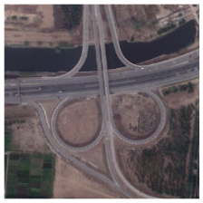
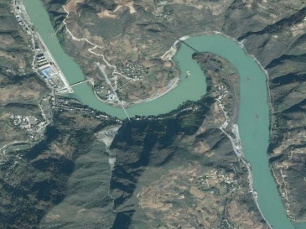
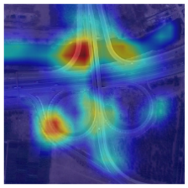
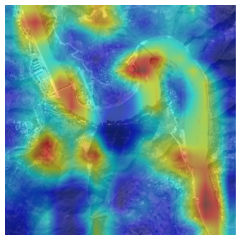

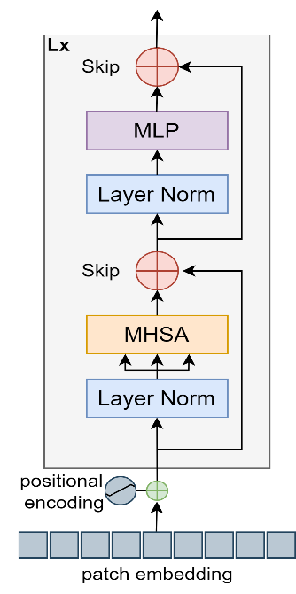
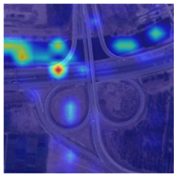
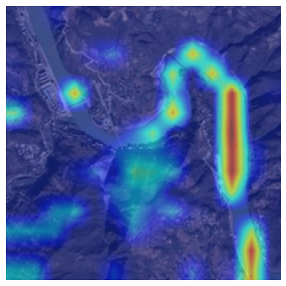
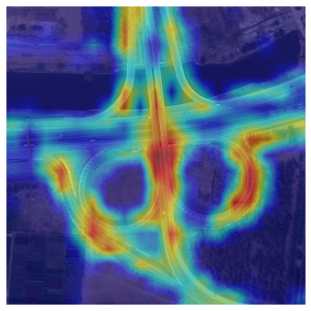
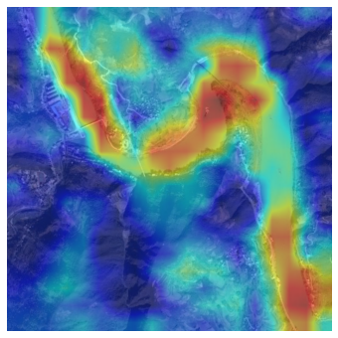

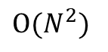
Context: Long-range dependencies refer to relationships between distant parts of an image where pixels or regions far apart still influence each other’s interpretation.
GRAD-CAM on AID Dataset
Input
A: short range
B: long-range
ResNet-50
So what’s the dilemma?
ViT
CNN
ViT-B/16
dilation
iiANET
$$O(N^{2})$$

Slide 4
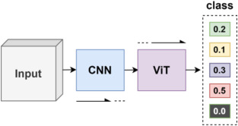
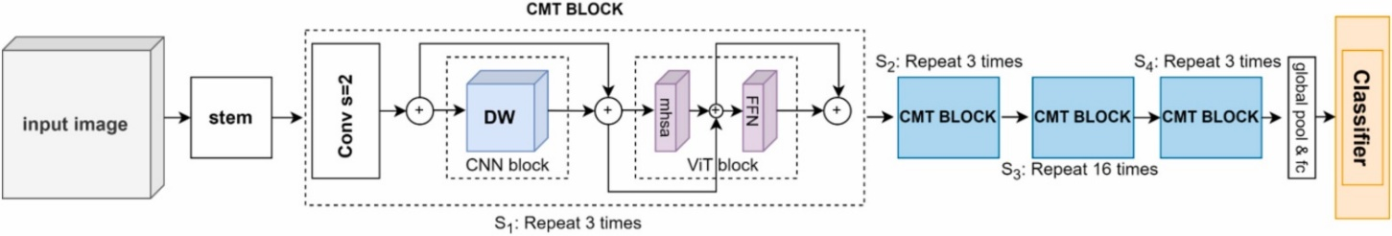
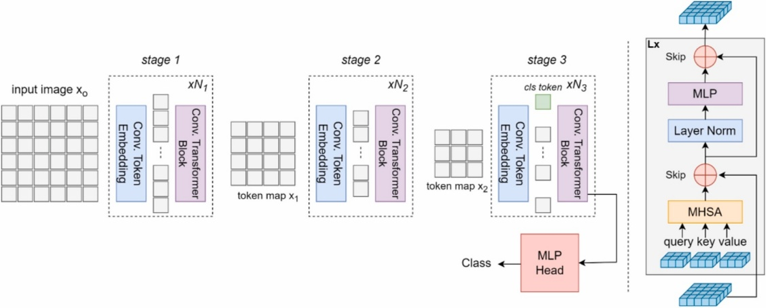
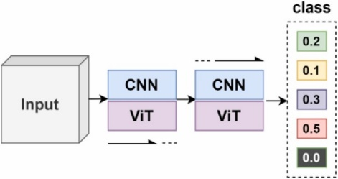
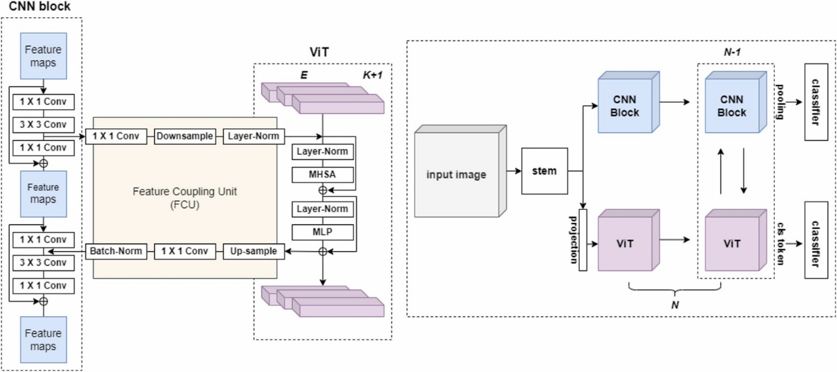
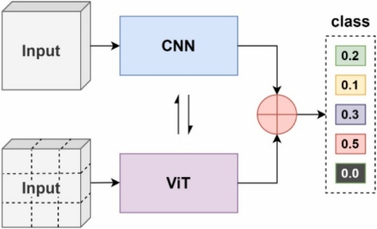
What's been done previously in hybrid?
Serial hybrid
Coatnet-3, 168M, 203.1G, 86.0%
Hierarchical hybrid
CoAtNet
CvT-W24, 277M, 193.2G, 87.7%
Parallel hybrid
Conformer-B, 83.3M, 23.3G, 84.1%
Our goal is to design an efficient hybrid CNN-based model that captures long-range dependencies from the earliest network layers.
iiANET: 50.9M 13.45G 84.9%

Slide 5
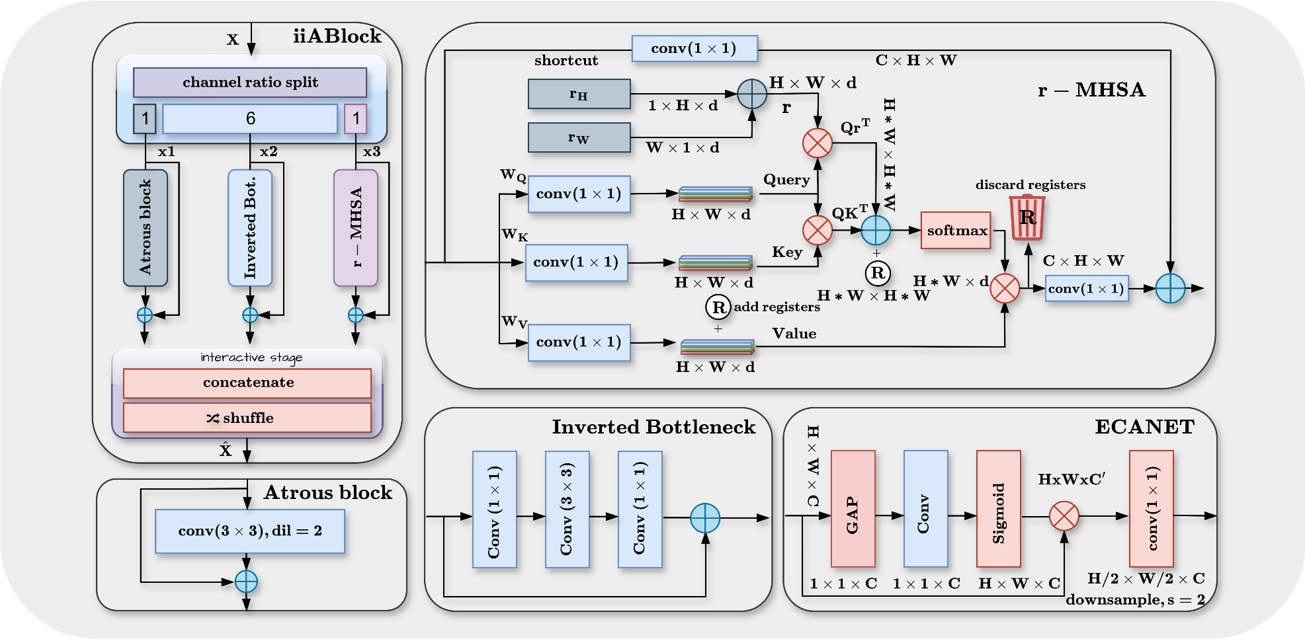
iiANET… simplicity and efficiency
iiANET Architectural Design
Inspired by the Inception model’s parallel design for feature extraction.

Slide 6
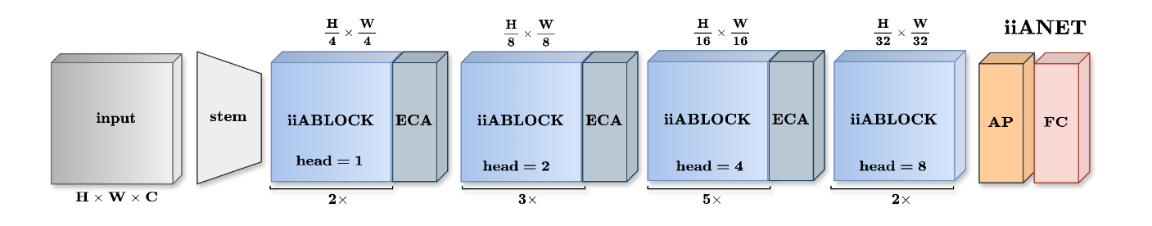
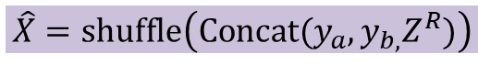
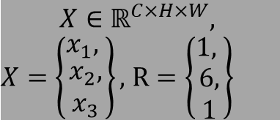
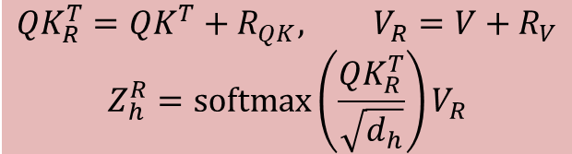
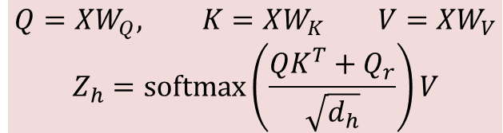
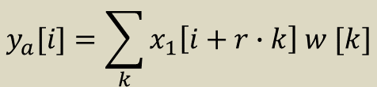
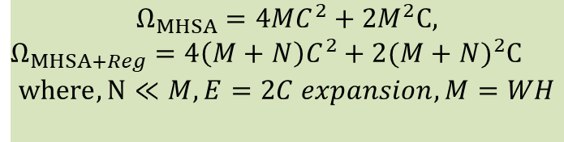
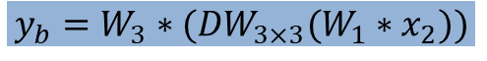
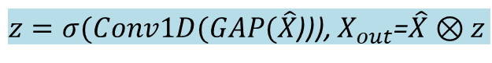
How it works …
$$y_{a}[i]=\sum_{k}{x_{1}\left[i+r∙k\right] w [k]}$$
$$X∈ℝ^{C×H×W},$$
$X=\left\{\begin{aligned}x_{1}, \\ \begin{aligned}x_{2}, \\ x_{3}\end{aligned}\end{aligned}\right\},$ $R=\left\{\begin{aligned}1, \\ \begin{aligned}6, \\ 1\end{aligned}\end{aligned}\right\}$
Input
Atrous block
$$y_{b}=W_{3}∗({DW}_{3×3}(W_{1}∗x_{2}))$$
Inverted bottleneck
global mhsa
$$Q={XW}_{Q}, K={XW}_{K} V={XW}_{V}$$
$$Z_{h}=softmax\left(\frac{{QK}^{T}+Q_{r}}{\sqrt{d_{h}}}\right)V$$
$$\hat{X}=shuffle\left(Concat(y_{a},y_{b,}Z^{R})\right)$$
fusion
$z=σ(Conv1D(GAP(\hat{X}$))), $X_{out}$=$\hat{X}⊗z$
ecanet
$${QK}_{R}^{T}={QK}^{T}+R_{QK}, V_{R}={V+R}_{V}$$
$$Z_{h}^{R}=softmax\left(\frac{{QK}_{R}^{T}}{\sqrt{d_{h}}}\right)V_{R}$$
$$Ω_{MHSA}={4MC}^{2}+{2M}^{2}C,$$
$Ω_{MHSA+Reg}={4\left(M+N\right)C}^{2}$ + ${2(M+N)}^{2}C$
$$where, N≪M, E=2C expansion, M=WH$$
mhsa + registers

Slide 7
Experimental datasets and settings
Dataset
AID: 10,000 images, 30 scene classes.
Oxford-III: 4,978 images, 37 cat and dog breeds.
COCO-2017
IMAGENET1K for generalization and robustness.
ADE20K
Experimental Setup
Core i7 8700k, 2 NVIDIA Titan XP GPUs, 32GB RAM.
Training: 90/150 epochs, batch size = 16.
AdamW optimizer, learning rate = 0.0001, decay = 0.05.
For fair Comparison: Re-trained comparison models on AID, Oxford-III, and RLD datasets.

Slide 8
Classification tasks
iiANET-L achieves CoAtNet-level accuracy with ≈60% fewer FLOPs and ≈3× fewer parameters.
iiANET-L achieves better Top-1 accuracy while remaining compute-efficient relative to CoAtNet and ViT.
iiANET-L shows good generalization, outperforming ResNet-101.

Slide 9
Detection and Segmentation
Faster R-CNN
DyHead
YOLOv8
YOLOv8
DINO
HTC++
ViTDeT
iiANET-L + YOLOv8 achieves the higher AP bbox on COCO test2017 (64.4)
iiANET-L achieves competitive performance.
iiANET-L achieves competitive performance.

Slide 10
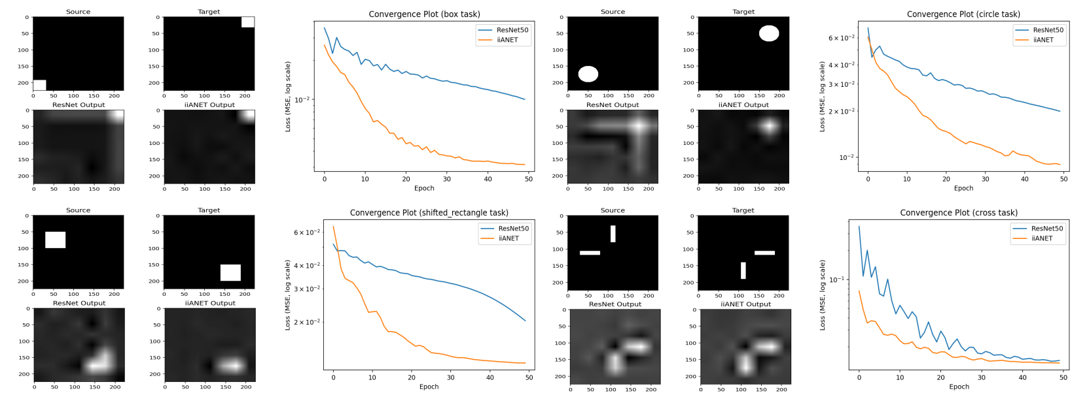
Visualizing long-range spatial transport
AdamW, lr=0.001, 50 epochs, input 224 , MSE loss
Notes:
Through image reconstrauction

Slide 11
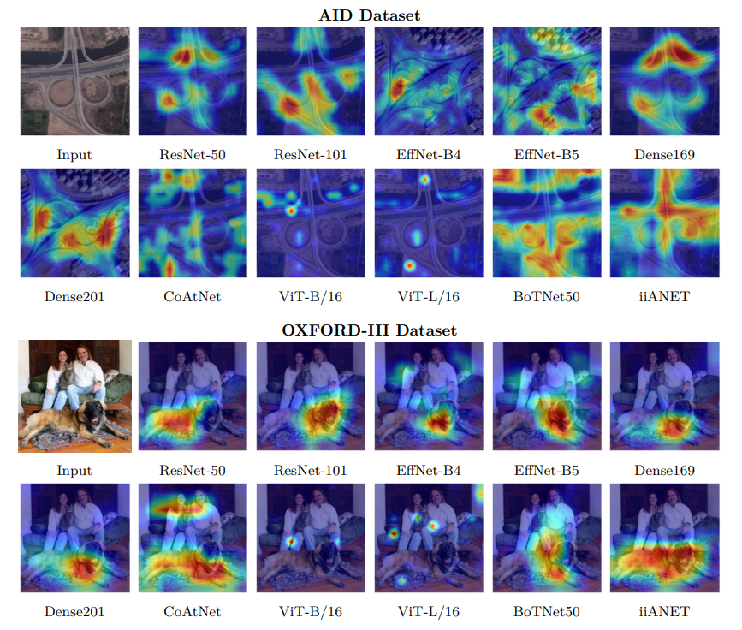
GRAD-Cam

Slide 12
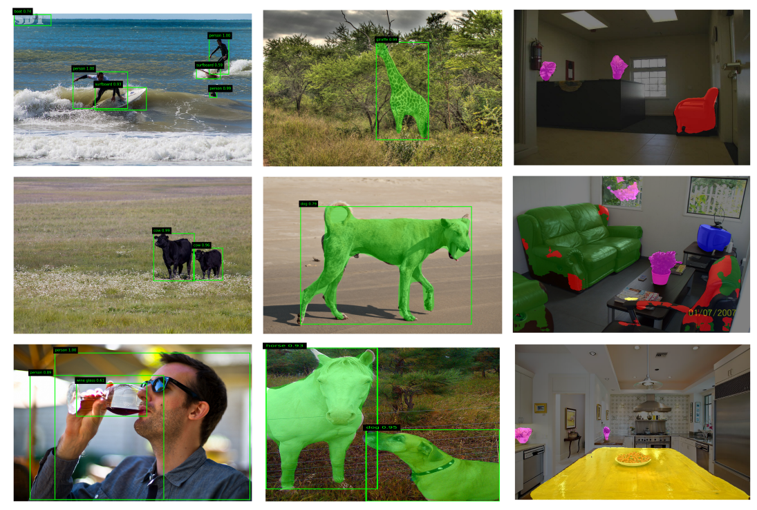
Qualitative…
Object Detection
Faster R-CNN
COCO17
Instance Segmentation
Mask R-CNN
COCO17
Semantic Segmentation
UPPERNET
ADE20K

Slide 13
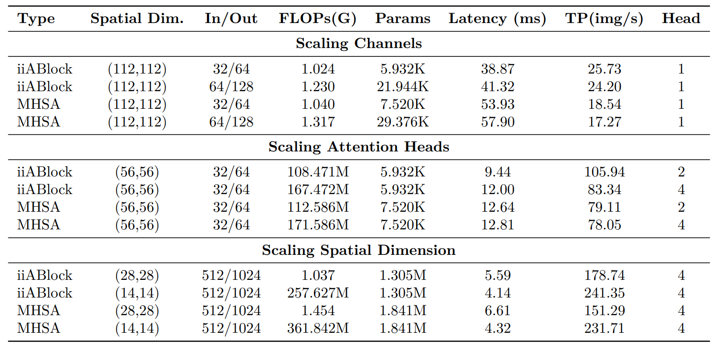
Ablations…
We performed ablation studies to analyze the impact of different components, scaling, and efficiency of iiANET.
Settings. All ablation experiments were conducted on the AID dataset Xia et al. (2017) using an NVIDIA GeForce RTX 2070 with Max-Q Design (8 GB VRAM), CUDA 12.1 and PyTorch 2.0.

Slide 14
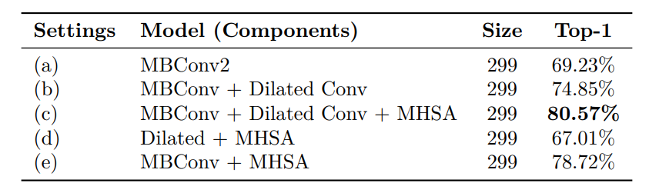
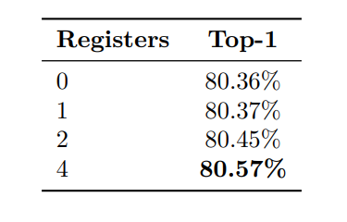
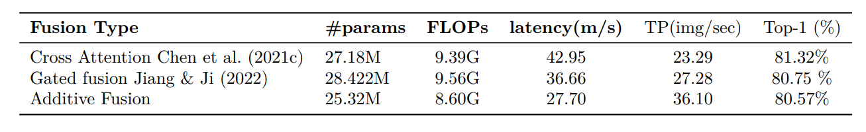
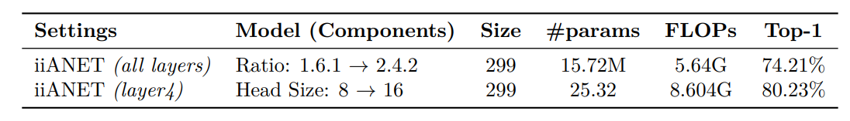
Contd…
Effects of different iiABlock variants on the AID dataset.
Effect of adding register tokens to 2D-MHSA mechanism
Ablation studies on fusion
effect of changing the MHSA head size and iiABlock ratio on AID dataset.

Slide 15
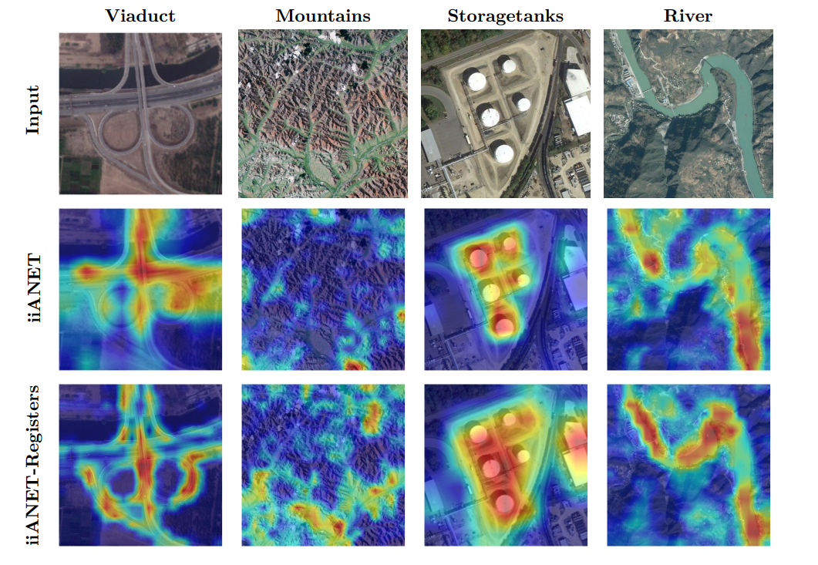
Contd…
Interpretability effects of adding registers

Slide 16
Conclusion and Limitation
iiANET achieves competitive performance across diverse visual downstream tasks, including classification, detection, and segmentation.
The architecture effectively enhances long-range dependency modeling, improving global contextual understanding in complex images.
iiANET maintains low computational complexity compared to ViT-based models, offering a favorable accuracy–efficiency trade-off.
The model is less effective for tasks dominated by strictly local visual patterns, where global context provides limited benefit.
The multi-branch design and channel-ratio configuration introduce scaling sensitivity, making optimal parameter selection task-dependent.
Parallel branch execution may introduce latency, as certain components may need to wait for others to complete during inference.

Slide 17
Future Work
Going beyond hybrid design,
Beyond attention

Slide 18
Thank you
&
Questions
yunusa2k2@gmail.com

